Slide 1
BUILDING ECONOMIC RESILIENCE IN 2024: STRATEGIES FOR A SUSTAINABLE FUTURE
Presentation by Bismarck Rewane
January 16, 2024

Slide 2
OUTLINE
01
Concept Definition
02
The Nigerian Economy – Snapshot Analysis & Inevitable Policy Changes
03
04
Policy Imperatives & Macroeconomic Impact
Budget as a Tool of Economic Management
05
Summary & Conclusion

Slide 3
AUDIENCE ANALYSIS
LCCI is the premier Chamber of Commerce in Nigeria
Founded in 1888 and incorporated in 1950
For the promotion and protection of Trade and Industry
Through regular consultations on policies and measures affecting businesses and the economy at large
Vision is to remain the foremost Chamber of Commerce and Industry
And be a role model for others in the promotion of sound business ethics and delivery of qualitative services

Slide 4
Concept Definition

Slide 5
WHAT IS ECONOMIC RESILIENCE?
Policy-induced ability of an economy to withstand or recover from the effects of shocks
A community’s ability to foresee, adapt to, and leverage changing conditions to their advantage
Economic resilience has 3 attributes:
The ability to recover quickly from a shock
The ability to withstand a shock
The ability to avoid a shock
United Nations University
The National Association of Counties
U.S. Economic Development Administration

Slide 6
ECONOMIC RESILIENCE INDEX
The economic resilience index covers four broad areas
Microeconomic Market Efficiency
Social Development
Good Governance
Macroeconomic Stability
There is a positive relationship between macroeconomic stability, social development, and good governance
Sweden, Denmark, Netherlands, and Ireland were among the top 10 countries with macroeconomic stability, social development, and good governance

Slide 7
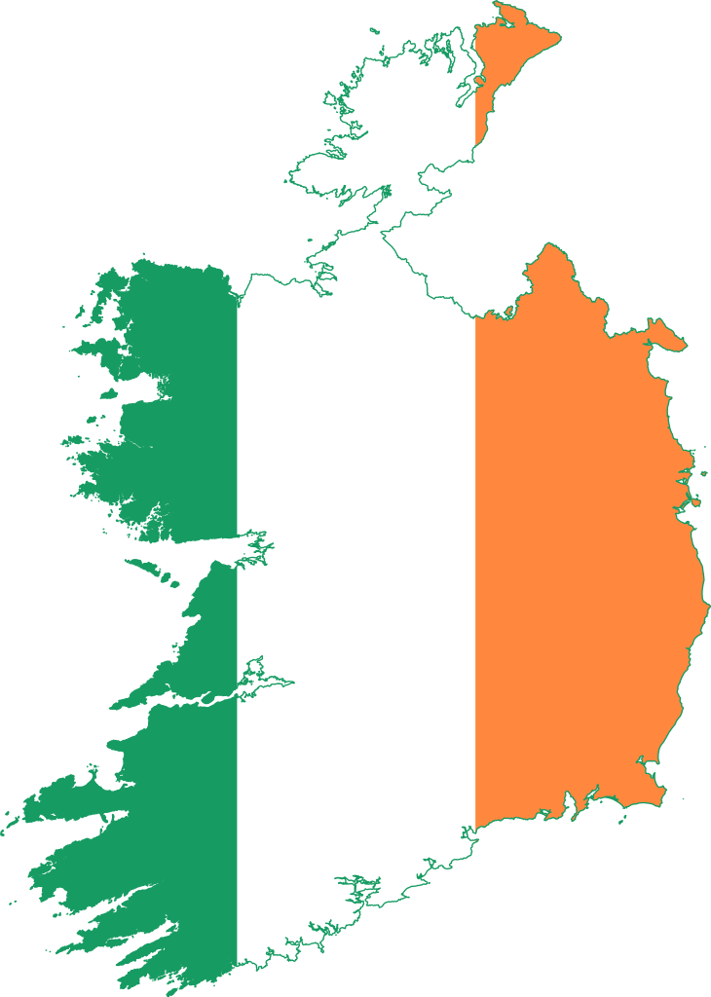
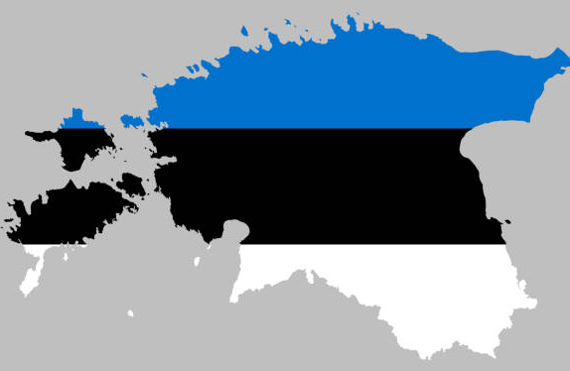
10 MOST ECONOMICALLY STABLE COUNTRIES
Sweden
0.78
Finland
0.74
Denmark
0.74
Netherlands
0.67
Germany
0.65
Austria
0.64
Ireland
0.63
Belgium
0.63
Estonia
0.62
France
0.56

Slide 8
HDI & GOVERNANCE EFFICIENCY RANKING
HDI RANKING – TOP 10
GOVERNANCE EFFICIENCY RANKING – TOP 10
Country | Rank | Score
Switzerland | 1 | 0.962
Norway | 2 | 0.961
Iceland | 3 | 0.959
Hong Kong | 4 | 0.952
Australia | 5 | 0.951
Denmark | 6 | 0.948
Sweden | 7 | 0.947
Ireland | 8 | 0.945
Germany | 9 | 0.942
Netherlands | 10 | 0.941
Nigeria | 162 | 0.535
Country | Rank | Score
Estonia | 1 | 76.0
Switzerland | 2 | 74.0
Norway | 3 | 73.0
Denmark | 4 | 72.4
Sweden | 5 | 72.2
Ireland | 6 | 72.2
Luxembourg | 7 | 71.7
Netherlands | 8 | 71.3
Finland | 9 | 71.2
New Zealand | 10 | 70.1
Nigeria | 162 | 37.5

Slide 9
The Nigerian Economy – Snapshot Analysis & Inevitable Policy Changes

Slide 10
SUSTAINED POSITIVE GROWTH
The Nigerian economy has avoided a recession in 2023 (2.3%) and is poised to grow at 3.3% in 2024

Slide 11
SOME SECTORS WILL OUTPERFORM THE NATIONAL AVERAGE
Some sectors like financial institutions, telecommunication, and construction are achieving growth over the national average
These sectors have the following features
Sector | GDP Growth rate (Q3’23) | Bank Exposure | Subsidy sensitivity
Financial institutions | 29.66 | 0.5 | Moderate
Telecommunication | 7.74 | 3 | Moderate
Construction | 3.89 | 10 | Low

Slide 12
SOME SECTORS HAVE BEEN IN RECESSION
Some sectors have been in recession despite positive economic growth
These sectors like crude petroleum and natural gas, oil refining, and textile and apparel also have huge banking sector credit exposure

Slide 13
KEY MACROECONOMIC CHALLENGES
Sub-optimal and non-inclusive growth
Real GDP (3.3%) < Potential GDP (4.9%)
Increasing income inequality
High poverty & unemployment rate
Spiraling inflation –
18-year high of 28.92%
Widening fiscal imbalances
Fiscal deficit as a % of GDP (5.0%)
Currency pressures
Naira climbs to N1,285/$

Slide 14
SPIRALING INFLATION – APPROACHING 29%
Nigerian inflation maintains its upward trend, rising to 28.92% in Dec’23
Largely driven by monetary and cost-push factors
Monetary conditions are loose and interest rates subsidized
Central Bank’s autonomy and independence is a work in progress
The negative real rate of return of 19.8% is a disincentive to save
National savings ratio is 20% of GDP
Gross fixed investment is 25.3% of GDP

Slide 15
EXTERNAL SECTOR VULNERABILITY
External debt (contractual and non-contractual) is 100% of total exports
External debt service to export ratio shows the external sector is vulnerable
Sectors of the economy that are exchange rate sensitive are similar to those with huge banking exposure
 | 2023[b] | 2024[c] | 2025[c]
External debt
Total external debt (US$ bn) | 85.5 | 87.4 | 93.1
Total external debt (% of GDP) | 22.5 | 25.5 | 29.5
Debt/exports ratio (%) | 97.5 | 100.1 | 112.5
Debt-service ratio, paid (%) | 14.1 | 14.1 | 11.4

Slide 16
STRUCTURE OF THE NIGERIAN FOREX MARKET
The Nigerian forex market is characterized by:
Lack of transparency and clear policy direction
Lack of effective price discovery measure
Capital controls and inefficiency
High speculation & arbitrage activities

Slide 17
NAIRA’S FREEFALL
Removal of ban on 43 Items
Initial convergence in exchange rates after the devaluation in the official market
NAFEM-Parallel gap thinned out to as low as N4.75
Naira has remained volatile in the parallel market primarily due to
Low interest rates
Naira speculation
Forex scarcity
NAFEM-parallel gap is now at N394.46
Reintroduction of forex controls
After FX reforms
Before FX reform

Slide 18
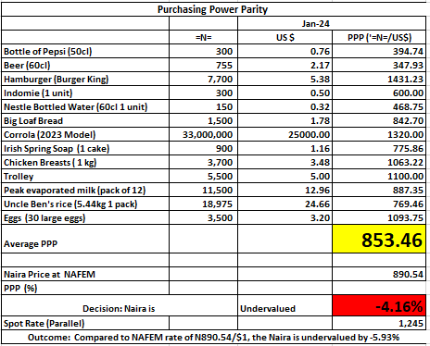
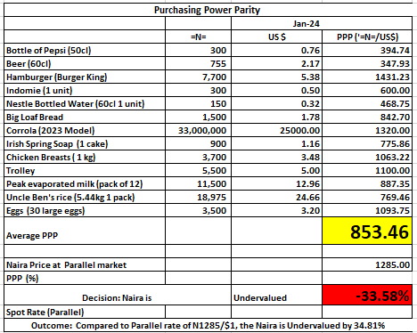
WHAT IS THE TRUE VALUE OF THE NAIRA?
Official Market
Parallel Market
Naira is undervalued by 33.58% at the parallel market rate of N1,285/$
Naira is undervalued by 4.16 at the NAFEM rate of N890.54/$
Parallel Market Rate
NAFEM Rate
PPP
Hamburger
N1,285/$
N890.54/$
N853.46/$
N1431.23/$

Slide 19
THE WAY FORWARD – INEVITABLE POLICY CHANGES IN 2024
Debt rescheduling (Externally)
Increase interest rates (Domestically)
Manage money supply more efficiently
Efficient foreign exchange market -
Adopt a wholesale dutch auction system
Cost reflective electricity tariff
Petrol subsidy reduction
Wage review

Slide 20
Policy Imperatives & Macroeconomic Impact

Slide 21
POLICY OPTIONS
Do the wrong things?
Do nothing?
Do the right things in small doses
Do the right things all at once
Sequencing

Slide 22
POLICY IMPERATIVES
Probability: High
Probability: Moderate
More aggressive tax collection
Increase in interest rates towards inflation rate
Increase tax to GDP ratio from 10.8% to 15%
Increase 365-day T/bill rate to 29% p.a
Currently at 8.39%p.a
Probability: High
Probability: Moderate
Further reduction of subsidies
An efficient foreign exchange market
Increase in PMS price towards diesel price – 27% to N800/ltr
Electricity tariff moves from N65/kWh to N90/kWh
Adopt a Wholesale Dutch Auction system to promote transparency & price discovery in the forex market
Probability: High
Minimum Wage Review
Likely increase in the minimum wage to N50,000 from N30,000

Slide 23
POLICY CHANGES & MACROECONOMIC IMPACT
GDP Growth (%)
Inflation (%; end-period)
H1’24
H2’24
H1’25
H1’24
H2’24
H1’25
2.9
3.7
4.0
28.5
25.30
19.20
Foreign Inflows ($’ bn)
Exchange Rate (parallel rate; N/$)
H1’24
H2’24
H1’25
H1’24
H2’24
H1’25
2.7
5.2
8.9
1,250
1,090
950
Fiscal Deficit (% of GDP)
H1’24
H2’24
H1’25
4.5
4.0
3.8

Slide 24
POLICY CHANGES AND IMPACT ON SMEs
Small and medium scale enterprises are mostly found in the following sectors
Trade
(54.67%)
Manufacturing (13.21%)
Agriculture (54.67%)
Sectors and % of total SME’s
Source: NBS, 2013
Accommodation & food services(5.51%)
Transportation & Storage (4.76%)

Slide 25
Policy Changes: Sector Opportunities & Threats

Slide 26
SECTOR SENSITIVITY
Sectors | Interest rates | Exchange rate | Petrol subsidy reduction | Cost reflective tariffs | Increased taxes | Wage review
Trade | High | High | High | High | High | High
Manufacturing | High | High | Moderate | High | High | High
Construction | High | High | Low | Low | High | High
Agriculture | High | High | High | Moderate | High | Moderate
Telecoms | High | High | Moderate | High | High | High
Oil and gas | Moderate | High | High | Moderate | High | High

Slide 27
AGRICULTURE SECTOR – IMPACT ANALYSIS
Upstream
Downstream
Production
Storage & Distribution
Interest rate hike
Borrowing costs
Increase in PMS price
Logistics costs
Exchange rate stability
Road concession
Post-harvest losses
Cost of agricultural inputs
Tractors and machines, seeds, e.t.c
Logistics constraints
Cost reflective tariff
Wage review
Power supply
Cost of labour
Sector is labour intensive
Reliance on other energy sources
Consumer demand

Slide 28
MANUFACTURING & TRADE SECTOR – IMPACT ANALYSIS
Upstream
Downstream
Production
Storage & Distribution
Interest rate increase
Borrowing cost
Distributor Finance
Exchange rate stability
Increase in PMS price
Logistics costs
Cost of raw materials
Minimum wage review
Cost of labour
Road/Airport & Seaport concessioning
Downtime
Consumer demand
Productivity
Cost reflective tariff
Wear & tear
Power supply
Reliance on other energy sources
Increased taxes
Profit after tax

Slide 29
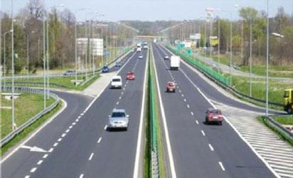
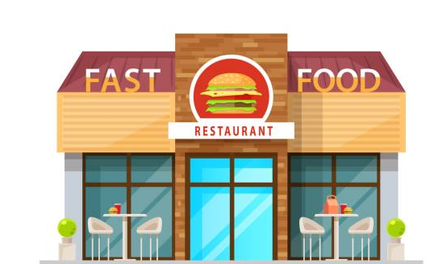
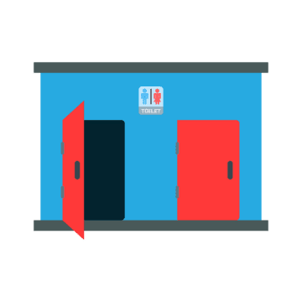
POLICY CHANGES - MAJOR OPPORTUNITIES
Proper structured repair centres
Fast foods
Road concessioning
Paid public services

Slide 30
POLICY CHANGES - MAJOR OPPORTUNITIES
Increased tax rate & efficient tax collection
Boost in state government revenue
Contractors are paid
Increased demand for cement and other commodities

Slide 31
POLICY CHANGES - MAJOR OPPORTUNITIES
Exchange rate sanitization
Export smuggling to reduce
Boost in global commodity supply
Lower food prices

Slide 32
Budget as a Tool of Economic Management

Slide 33
KEY FISCAL POLICY OBJECTIVES
Stimulate output growth
Boost employment level
Equitable distribution of income & wealth
Boost in investment level
Debt management

Slide 34
2024 APPROPRIATION ACT
Budget expenditure increased by 31.84% to N28.78trn in 2024 from N21.83trn in 2023
However, in dollar terms, the budget size is reducing ($23.71bn)

Slide 35
BUDGET CHARACTERISTICS
How much to spend (expenditure)
How much to earn (revenue)
Difference between expenditure & revenue
How to fund the budget
Budget as a tool of economic management

Slide 36
2024 BUDGET BREAKDOWN
Revenue – N19.6trn
Expenditure – N28.78trn
Nigeria has underperformed its revenue target by an average of 40% in the last 5 years
Average revenue in the last 5 years = N4.39trn
Debt service = N8.2trn
Non-debt recurrent exp. = N8.7trn
Capex = N9.99trn
Recurrent exp. = N8.77trn
Fiscal Deficit – N9.18trn (3.88% of GDP)
To be funded through borrowing
New borrowing = N7.82trn
Privatization proceeds = N298.49bn
Multilateral & Bilateral loans = N1.05trn

Slide 37
TYPES OF BUDGET
Balanced Budget
Government expenditure equals expected revenue
Surplus Budget
Expected revenue exceeds planned expenditure
Deficit Budget
Planned expenditure exceeds estimated revenue
Expansionary fiscal policy
Contractionary fiscal policy

Slide 38
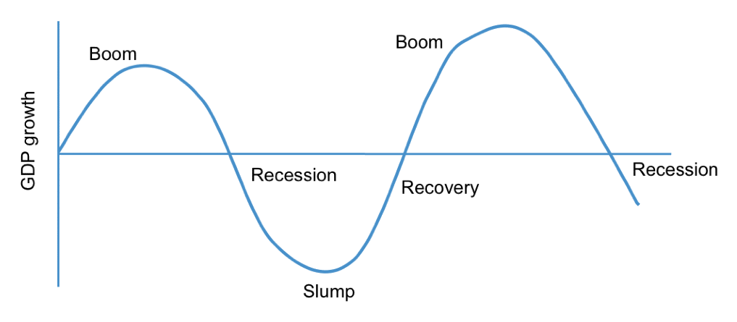
BUDGET IN A PERIOD OF ECONOMIC DOWNTURN
Keynes is an advocate of a countercyclical fiscal policy during periods of economic downturns
Nigeria has consistently adopted a deficit budget for over three decades
Aimed at boosting aggregate demand and stimulating output growth

Slide 39
BUDGET DEFICIT VS GDP GROWTH
Deficit spending is yet to yield the intended impact on the economy
Fiscal spending not complemented with adequate investment (domestic & foreign investments)

Slide 40
GOALS OF THE 2024 BUDGET – VAGUE TARGETS
Achieve Job-rich economic growth – 3.76%
Macroeconomic stability – inflation (21.4%)
Reduce fiscal deficit
– from N13.78trn to N9.18trn
Increase revenue to GDP
from less than 10% to 18%
Reduce the cost of doing business & cost of living of an average Nigerian
Poverty reduction
Enhanced human capital development
Better investment environment
Increase capital spend

Slide 41
BUDGET ASSUMPTIONS
Indicators | 2023 | 2024 | Comments
GDP growth (%) | 3.75 | 3.88 | Average growth rate in the last 5 years = 1.9% IMF projects 2.9% for 2024 while EIU forecasts 2.6%
Oil price ($pb) | 75 | 77.96 | Initial projection = $73.96pb 2024 JP Morgan estimates - $90 - $110/pb
Oil production (mbpd) | 1.69 | 1.78 | Average oil production in the past 5 years =1.53mbpd
Exchange rate (N/$) | 435.57 | 800 | Initial forecast = N700/$ Parallel market rate currently N1,285/$
Inflation (%) | 16.98 | 21.4 | IMF – 23 EIU – 23.5

Slide 42
BUDGET PERFORMANCE IN THE LAST TWO YEARS
Indicators | 2022 |  | 2023
 | Targets | Actual | Targets | Actual
GDP growth (%) | 4.2 | 3.25 | 3.75 | 2.45
Oil price ($pb) | 57 | 98.8 | 75 | 83.64
Oil production (mbpd, avg.) | 1.88 | 1.21 | 1.69 | 1.32
Exchange rate (N/$, end period) | 410.15 | 740 | 435.57 | 1,158
Inflation (%, end period) | 13 | 21.34 | 16.98 | 27.33

Slide 43
Summary & Conclusion

Slide 44
SUMMARY & CONCLUSION
Nigeria has consistently adopted a deficit budget
A countercyclical fiscal policy aimed at boosting aggregate demand and economic growth
Nigeria’s intersectoral linkages are weak and tenuous
Production Processing Markets
Increased infrastructure spend will strengthen intersectoral linkages
Improved linkages will buoy output and reduce inflation
Leading to a virtuous cycle of prosperity

Slide 45
SUMMARY & CONCLUSION
Nigeria will remain more integrated with the global and regional economy
Nigeria will be vulnerable to exogenous shocks especially global oil prices and supply chain shocks
Nigeria will also need to come to terms with its domestic and external debt situation
Expected to begin talks with the IMF and reschedule its external debt
There are lags between policies, the initial impact, and the final impact
H1’24 – Decision making
H2’24 – Policy implementation
H1’25 – Results(economic takeoff)
Policy reforms without institutional reforms will only make things worse

Slide 46
SUMMARY & CONCLUSION
Economy is stratified into 5 different levels
First beneficiary – Government (Shift of revenue from consumers to the government)
Second beneficiary – Multinationals & Conglomerate (increased investment)
Third beneficiary – Commercials & SME’s and retail
Government
Multinationals
Conglomerate
Commercials
SME’s & retail

Slide 47
THANK YOU

